Slide 1
Chapter 17
Limited Dependent Variable Models and Sample Selection Corrections

Slide 2
Limited Dependent Variable Models and Sample Selection Corrections (1 of 31)
Limited dependent variables (LDV)
LDV are is substantively restricted
Binary vavariables whose range riables, e.g. employed/not employed
Nonnegative variables, e.g. wages, prices, interest rates
Nonnegative variables with excess zeros, e.g. labor supply
Count variables, e.g. the number of arrests in a year
Censored variables, e.g. unemployment durations
Sample selection models
The sample used to infer population relationships is endogenously selected, e.g. wage offer regression but data only about working women.

Slide 3
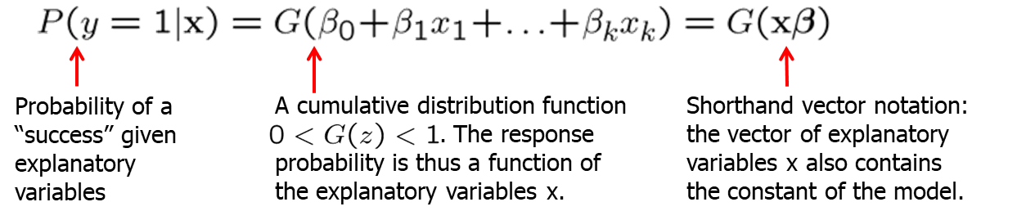
Limited Dependent Variable Models and Sample Selection Corrections (2 of 31)
Logit and Probit models for binary response
Disadvantages of the LPM for binary dependent variables
Predictions sometimes lie outside the unit interval
Partial effects of explanatory variables are constant
Nonlinear models for binary response
Response probability is a nonlinear function of explanat. variables

Slide 4
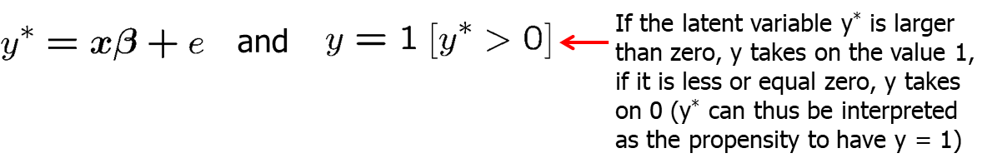
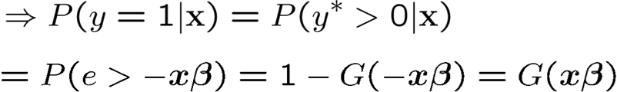
Limited Dependent Variable Models and Sample Selection Corrections (3 of 31)
Choices for the link function
Latent variable formulation of the Logit and Probit models

Slide 5
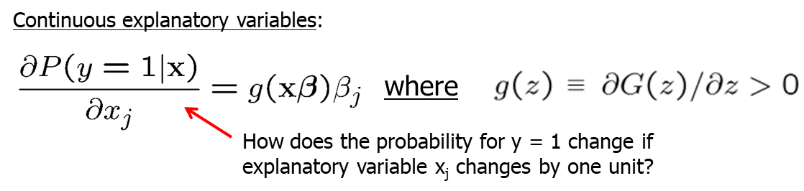
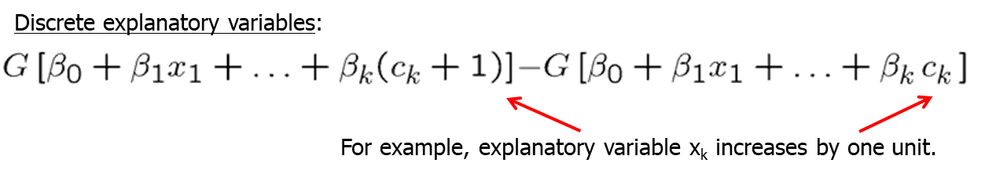
Limited Dependent Variable Models and Sample Selection Corrections (4 of 31)
Interpretation of coefficients in Logit and Probit models
Partial effects are nonlinear and depend on the level of x.

Slide 6
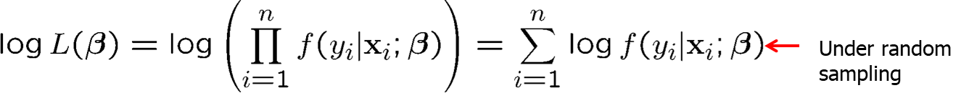
Limited Dependent Variable Models and Sample Selection Corrections (5 of 31)
Maximum likelihood estimation of Logit and Probit models
Properties of maximum likelihood estimators
Maximum likelihood estimators are consistent, asymptotically normal, and asymptotically efficient if the distributional assumptions hold.

Slide 7
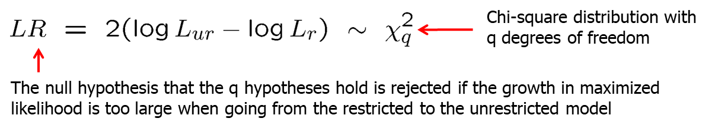
Limited Dependent Variable Models and Sample Selection Corrections (6 of 31)
Hypothesis testing after maximum likelihood estimation
The usual t-tests and confidence intervals can be used.
There are three alternatives to test multiple hypotheses:
Lagrange multiplier or score test (not discussed here)
Wald test (requires only estimation of unrestricted model)
Likelihood ratio test (restricted and unrestricted models needed)

Slide 8
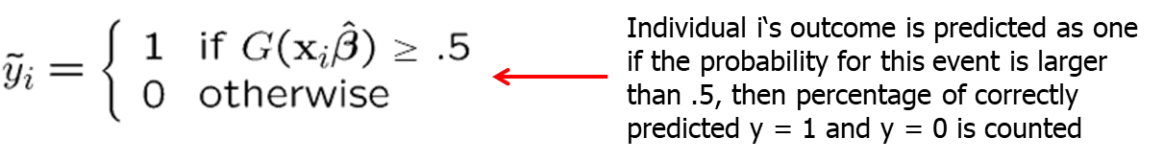
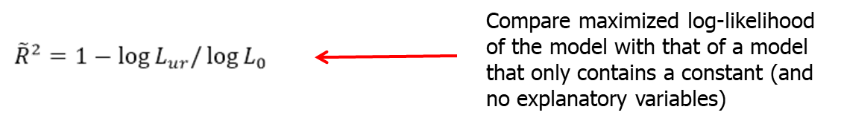
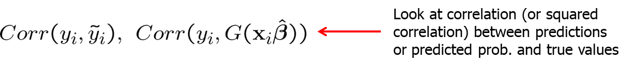
Limited Dependent Variable Models and Sample Selection Corrections (7 of 31)
Goodness-of-fit measures for Logit and Probit models
Percent correctly predicted
Pseudo R-squared
Correlation based measures

Slide 9
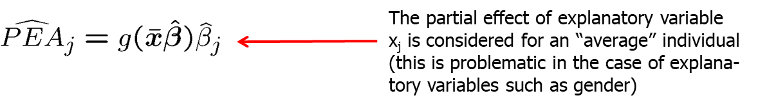
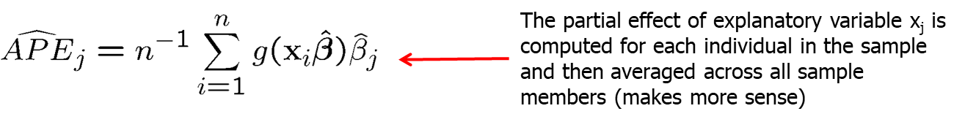
Limited Dependent Variable Models and Sample Selection Corrections (8 of 31)
Reporting partial effects of explanatory variables
The difficulty is that partial effects are not constant but depend on.
Partial effects at the average:
Average partial effects:
Analogous formulas hold for discrete explanatory variables.

Slide 10
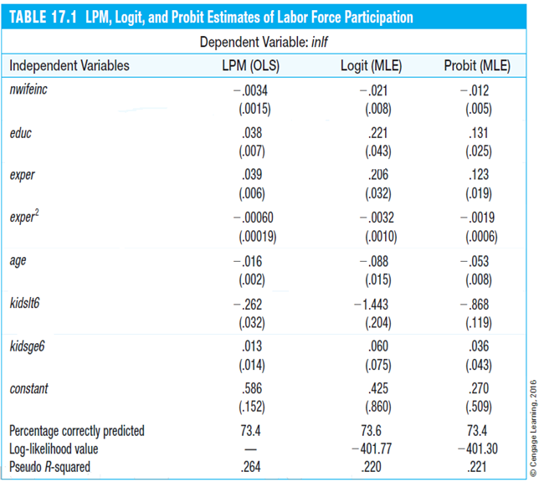
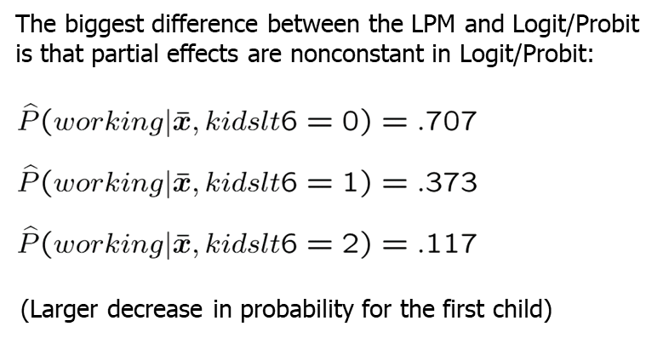
Limited Dependent Variable Models and Sample Selection Corrections (9 of 31)
Example: Married women’s labor force participation
Independent Variables | LPM (OLS) | Logit (MLE) | Probit (MLE)
nwifeinc | -.0034 (.0015) | -.021 (.008) | -.012 (.005)
educ | .038 (.007) | .221 (.043) | .131 (.025)
exper | .039 (.006) | .206 (.032) | .123 (.019)
exper² | -.00060 (.00019) | -.0032 (.0010) | -.0019 (.0006)
age | -.016 (.002) | -.088 (.015) | -.053 (.008)
kidslt6 | -.262 (.032) | -1.443 (.204) | -.868 (.119)
kidsage6 | .013 (.014) | .060 (.075) | .036 (.043)
constant | .586 (.152) | .425 (.860) | .270 (.509)
Percent correctly predicted | 73.4 | 73.6 | 73.4
Log-likelihood value | - | -401.77 | -401.30
Pseudo R-Squared | .264 | .220 | .221

Slide 11
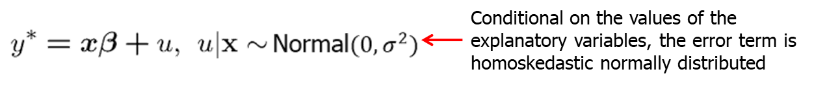
Limited Dependent Variable Models and Sample Selection Corrections (10 of 31)
The Tobit model for corner solution responses
In many economic contexts, decision problems are such that either a positive amount or a zero amount is chosen (e.g. demand for alcohol).
A linear regression model may be inadequate in such cases as predictions may be negative and effects of explanatory variables are linear.
The Tobit model also makes use of a latent variable formulation.
Definition of the Tobit model

Slide 12
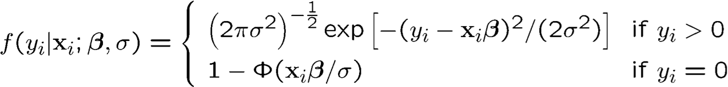
Limited Dependent Variable Models and Sample Selection Corrections (11 of 31)
Maximum likelihood estimation of the Tobit model
For positive outcomes, the normal density is used. For zero outcomes the probability is one minus the probability that the latent variable is greater than zero (see Probit).
As in the Logit/Probit case, the maximization problem is highly nonlinear. It cannot be solved analy-tically and has to be solved with the help of computer software using e.g. Newton-Raphson methods.

Slide 13
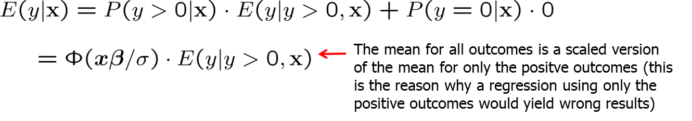
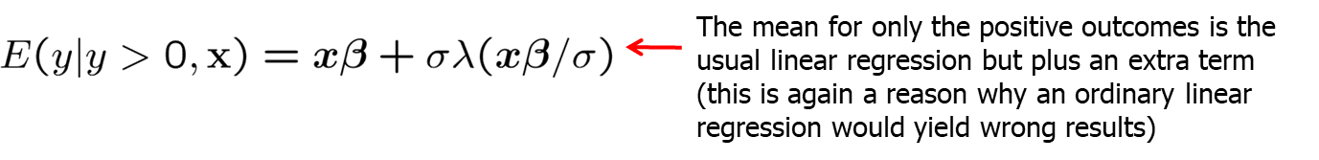
Limited Dependent Variable Models and Sample Selection Corrections (12 of 31)
Interpretation of the coefficients in the Tobit model
Conditional mean for all outcomes:
Conditional mean for positive outcomes:

Slide 14
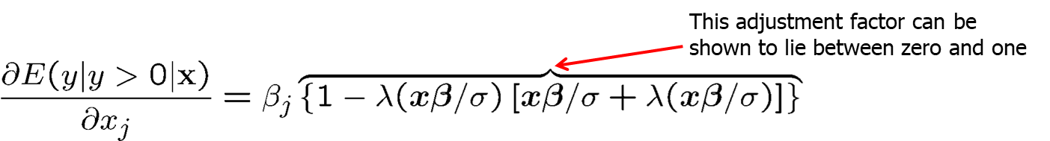
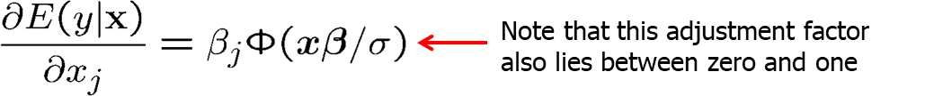
Limited Dependent Variable Models and Sample Selection Corrections (13 of 31)
Partial effects of interest in the Tobit model
On the probability for a nonzero outcome:
On the mean for positive outcomes:
On the mean of all possible outcomes including zero:

Slide 15
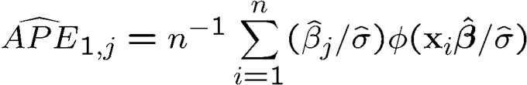
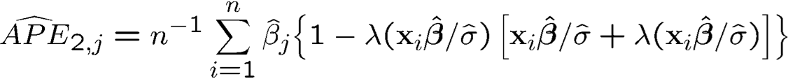
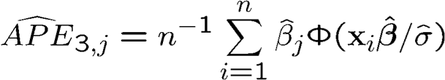
Limited Dependent Variable Models and Sample Selection Corrections (14 of 31)
Estimation of average partial effects in the Tobit model
On the probability for a nonzero outcome:
On the mean for positive outcomes:
On the mean of all possible outcomes including zero:

Slide 16
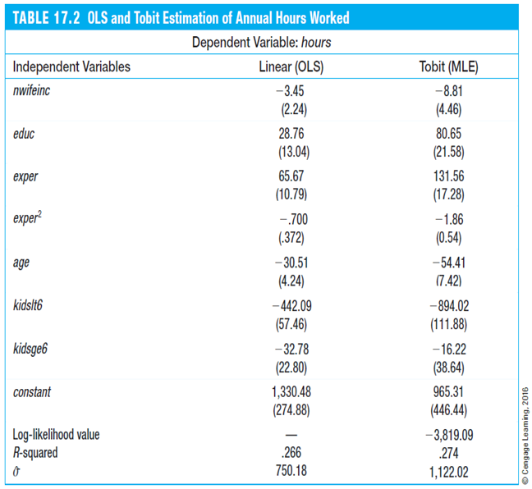
Limited Dependent Variable Models and Sample Selection Corrections (15 of 31)
Example: Annual hours worked of married women
Independent Variables | Linear (OLS) | Tobit (MLE)
Nwifeinc | -3.45 (2.24) | -8.81 (4.46)
educ | 28.76 (13.04) | 80.65 (21.58)
exper | 65.67 (10.79) | 131.56 (17.28)
exper² | -.700 (.372) | -1.86 (0.54)
age | -30.51 (4.24) | -54.41 (7.42)
kidslt6 | -442.09 (57.46) | -894.02 (111.88)
kidsage6 | -32.78 (22.80) | -16.22 (38.64)
constant | 1,330.48 (274.88) | 965.31 (446.44)
Log-likelihood value | - | -3,819.09
R-Squared | .266 | .274
σ hat | 750.18 | 1,122.02
Because of the different scaling factors involved, Tobit coefficients are not comparable to OLS coefficients.
To compare Tobit and OLS, one has to compare average partial effects (or partial effects at the average). It turns out that partial effects of Tobit and OLS are different in a number of cases.
Another difference between Tobit and OLS is that, due to the linearity of the model, OLS assumes constant partial effects, whereas partial effects are nonconstant in Tobit.
In the given example, OLS yields negative annual hours for 39 out of 753 women. This is not much but it may be a reason to view the linear model as misspecified.

Slide 17
Limited Dependent Variable Models and Sample Selection Corrections (16 of 31)
Specification issues in Tobit/Logit/Probit models
A restriction of the Tobit model is that explanatory variables influence positive outcomes and the probability of positive outcomes in the same way.
This may be unrealistic in many cases, for example, when modeling the relationship between the amount of life insurance and a person‘s age.
For such cases, more advanced so-called hurdle models can be used.
As in Logit/Probit models, heteroskedasticity may be an issue in Tobit.
ML estimates may be wrong if distributional assumptions do not hold.
There are methods to deal with endogeneity in Logit/Probit/Tobit.
Logit/Probit/Tobit models are also available for panel/time series data.

Slide 18
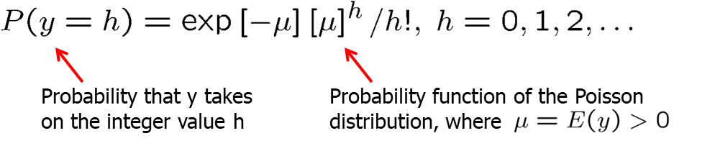
Limited Dependent Variable Models and Sample Selection Corrections (17 of 31)
The Poisson regression model for count data
Model the mean of the dependent variable as a function of explanatory variables:
The Poisson regression model models a count variable as a function of explanatory variables:

Slide 19
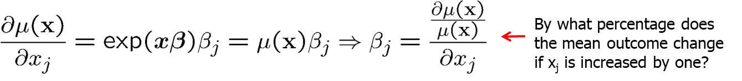
Limited Dependent Variable Models and Sample Selection Corrections (18 of 31)
Interpretation of the coefficients of the Poisson regression
Maximum likelihood estimation of the Poisson regression model
A limitation of the model is that it assumes the expected value of y is equal to the variance of y (a feature of the Poisson distribution).
But ML estimators in the Poisson regression model are consistent and asymptotically normal even if the Poisson distribution does not hold.

Slide 20
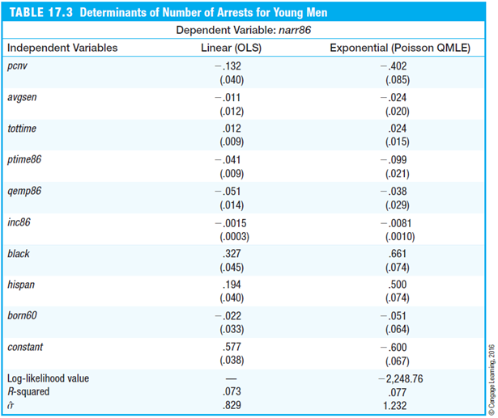
Limited Dependent Variable Models and Sample Selection Corrections (19 of 31)
Example: Poisson regression for number of arrests
Independent Variables | Linear (OLS) | Exponential (Poisson QMLE)
Pcnv | -1.32 (.040) | -.402 (.085)
Avgsen | -.011 (.012) | -.024 (.020)
Tottime | .012 (.009) | .024 (.015)
Ptime86 | -.041 (.009) | -.099 (.021)
Qemp86 | -.051 (.014) | -.038 (.029)
Inc86 | -.0015 (.0003) | -.0081 (.0010)
Black | .327 (.045) | .661 (.074)
Hispan | .194 (.040) | .500 (.074)
Born60 | -.022 (.033) | -.051 (.064)
Constant | .577 (.038) | -.600 (.067)
Log-likelihood value | - | -2,248.76
R-squared | .073 | .077
Sigma hat | .829 | 1.232
The expected number of arrests was 2.4 percentage points lower if the average sentence length was 1 month higher.
If the assumption of a Poisson distribution does not hold, ML is still consistent and asymptotically normal. This is called Quasi-Maximum Likelihood estimation (QML).
If the distributional assumptions do not hold and QML is used, standard errors are wrong. One then has to compute robust standard errors (this has not been done here).
Because sigma hat equals 1.232, there is evidence for overdispersion – in other words the expected value and variance are not equal to one another.
This is evidence that the Poisson distribution does not hold and robust standard errors have to be computed.
Alternatively one can inflate standard errors by sigma hat.

Slide 21
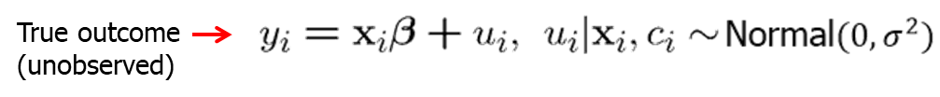
Limited Dependent Variable Models and Sample Selection Corrections (20 of 31)
The censored regression model
In many cases, the dependent variable is censored in the sense that values are only reported up to a certain level (e.g. top coded wealth).
Censored normal regression model:
Regressing y_{i} on x_{i} would yield correct results but y_{i} is unobserved.
Regressing w_{i} on x_{i} will yield incorrect results (even if only the un-censored observations are used in this regression).

Slide 22
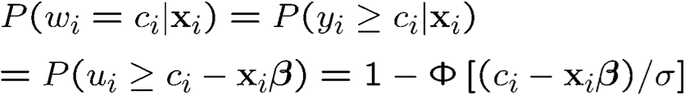
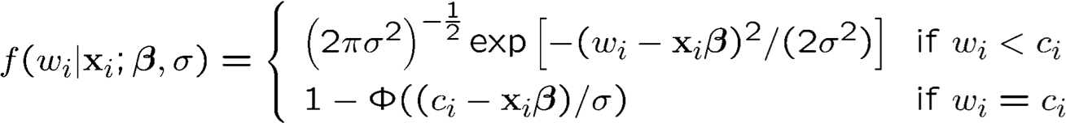
Limited Dependent Variable Models and Sample Selection Corrections (21 of 31)
Maximum likelihood estimation of the censored regression model
Probability/density function of observed outcome conditional on explanatory variables:
Maximization of log-likelihood:

Slide 23
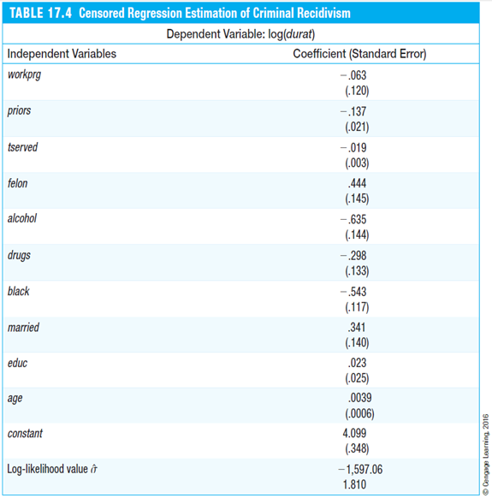
Limited Dependent Variable Models and Sample Selection Corrections (22 of 31)
Example: Censored regression estimation of criminal recidivism
Independent Variables | Coefficient (Standard Error)
Workprg | -.063 (.120)
Priors | -.137 (.021)
Tserved | -.019 (.003)
Felon | .444 (.145)
Alcohol | -.635 (.144)
Drugs | -.298 (.133)
Black | -.543 (.117)
Married | .341 (.140)
Educ | .023 (.025)
Age | .0039 (.0006)
Constant | 4.009 (.348)
Log-likelihood value | -1,597.06
Sigma hat | 1.810
The variable durat measures the time in months until a prison inmate is arrested after being released from prison. Of 1,445 inmates, 893 had not been arrested during the time they were followed. Their time out of prison is censored (because its end, if there was one, was not observed).
For example, if the time in prison was one month longer, this reduced the expected duration until the next arrest by about 1.9%.
In the censored regression model, the coefficients can be di-rectly interpreted. This is contrary to the Tobit model, where coefficients cannot be directly interpreted. The censored regression model and the Tobit model have a similar structure, but in the Tobit model, the outcome is of a nonlinear nature whereas in the censored regression model, the outcome is linear but incompletely observed.

Slide 24
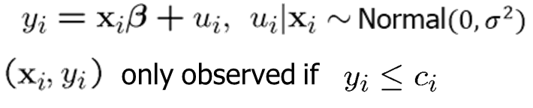
Limited Dependent Variable Models and Sample Selection Corrections (23 of 31)
Truncated regression models
In a truncated regression model the outcome and the explanatory variables are only observed if the outcome is less or equal some value c_{i.}
In this case, the sample is not a random sample from the population (because some units will never be a part of the sample).
Truncated normal regression model:
Applying OLS would not yield correct results because MLR.2 is violated.

Slide 25
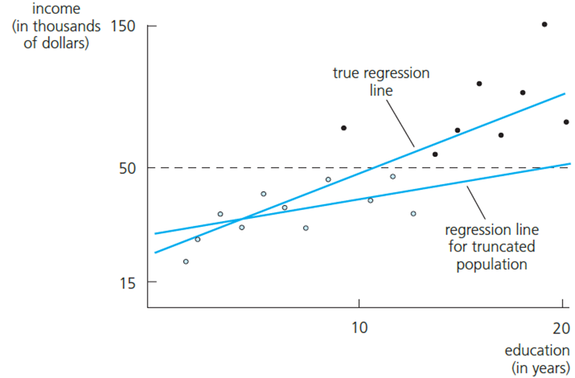
Limited Dependent Variable Models and Sample Selection Corrections (24 of 31)
Example: A regression based on a truncated sample
One is interested in the relationship between income and education in the whole population but sampling was done so that only individuals with in-come below $50,000 were sampled.
Direct application of OLS would lead to an underestimation of the slope coefficient because high incomes are omitted.

Slide 26
Limited Dependent Variable Models and Sample Selection Corrections (25 of 31)
Maximum likelihood estimation of the truncated regression model
Likelihood maximization:
As in the censored regression model, nonnormality or heteroskedasticity in the truncated regression model lead to inconsistency.

Slide 27
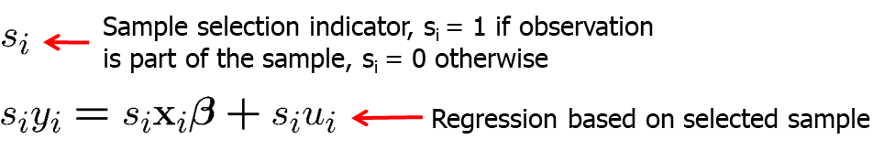
Limited Dependent Variable Models and Sample Selection Corrections (26 of 31)
Sample selection corrections
The question is under which assumptions a sample with nonrandom sample selection can be used to infer relationships in the population.
When is OLS on the selected sample consistent?

Slide 28
Limited Dependent Variable Models and Sample Selection Corrections (27 of 31)
Three cases in which OLS on the selected sample is consistent
Selection is independent of explanatory variables and the error term.
Selection is completely determined by explanatory variables.
Selection depends on the explanatory variables and other factors that are uncorrelated with the error term.
Similar results apply to IV/2SLS estimation
Instead of for explanatory variables, the conditions have to hold for the full list of exogenous variables that are used in the model.
Sample selection and nonlinear models estimated by ML
Consistency if sample selection is only determined by explanatory variables.

Slide 29
Limited Dependent Variable Models and Sample Selection Corrections (28 of 31)
Incidental truncation (Heckman model)
Example: Wage offer function using sample of working women
One is interested in the wage of a woman with certain characteristics would be offered on the labor market if she decided to work.
Unfortunately, one only observes the wages of women who actually work, i.e. who have accepted the wage offered to them.
The sample is truncated because women who do not work (but who would be offered a wage if they asked for it) are never in the sample.
Truncation of this kind is called incidental truncation because it depends on another variable (here: labor force participation).

Slide 30
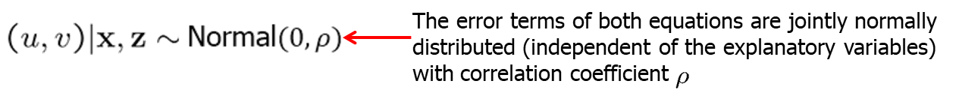
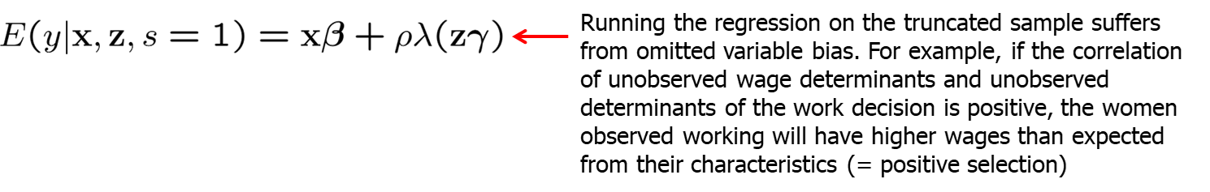
Limited Dependent Variable Models and Sample Selection Corrections (29 of 31)
Definition of Heckman model
Selection bias in OLS

Slide 31
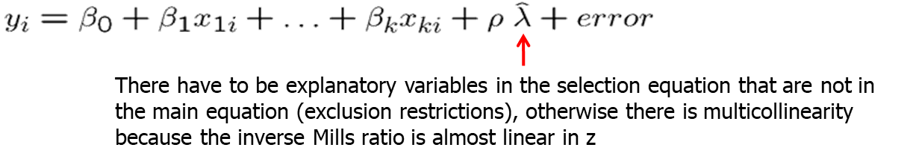
Limited Dependent Variable Models and Sample Selection Corrections (30 of 31)
Estimation of Heckman model
1) Estimation of correction term:
2) Include estimated correction term in regression:

Slide 32
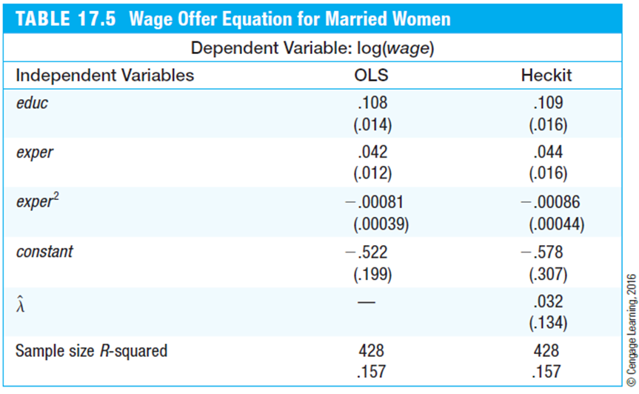
Limited Dependent Variable Models and Sample Selection Corrections (31 of 31)
Example: Wage offer equation for married women
Independent Variables | OLS | Heckit
Educ | .108 (.014) | .109 (.016)
Exper | .042 (.012) | .044 (.016)
Exper squared | -.00081 (.00039) | -.00086 (.00044)
Constant | -.522 (.199) | -.578 (.307)
Lambda hat | - | .032 (.134)
Sample size | 428 | 428
R squared | .157 | .157
The standard errors of the two-step Heckman method are actually wrong and have to be corrected (not done here). One can also use a maximum likelihood procedure.
There is no significant sample selection. This is the reason why OLS and Heckman estimates (“Heckit”) are so similar.

